Slide 1
Witnesses to War II
Witnessing:
Kluger’s memoir
Nanking Film
--witness testimony
--staged reading of primary documents
A more mediated form of witnessing: Horrors of War Bubble Gum Cards
News and historical information
Lurid illustrations
Brief texts explaining the significance of the illustration
To know the HORRORS OF WAR is to want PEACE

Slide 2
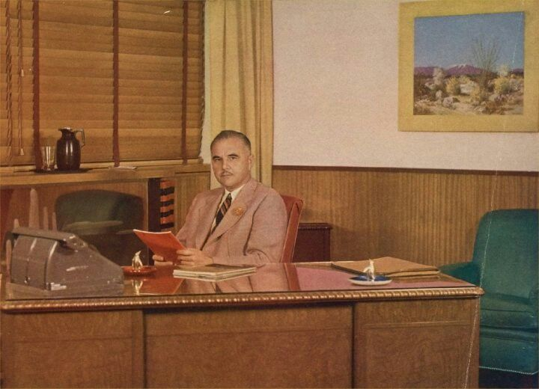
J. Warren Bowman of Gum, Inc. collborated with George Moll on cards

Slide 3
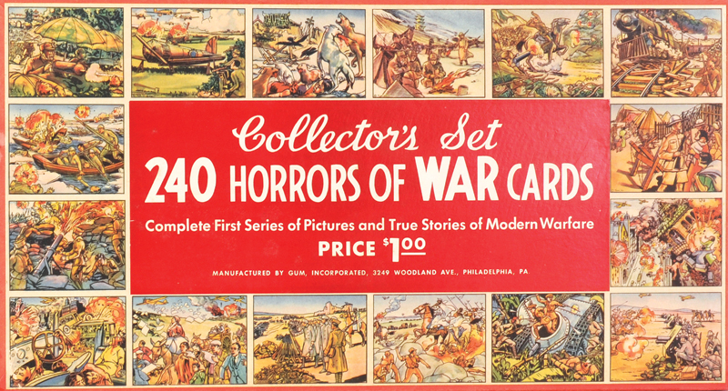
From Gum Inc. promotional material:
Much can be accomplished in the way of forming an attitude against war and for
Peace by showing children of an impressionable age what war really means. No child can
Look at these pictures of its destruction without getting the idea that war is wrong. With
A whole generation growing up with an anti-war fixation attributable to these cards,
It should go a long way toward bringing about a state of Patriotic Peace throughout
The United States and eventually throughout the World. (Collectors Set)

Slide 4
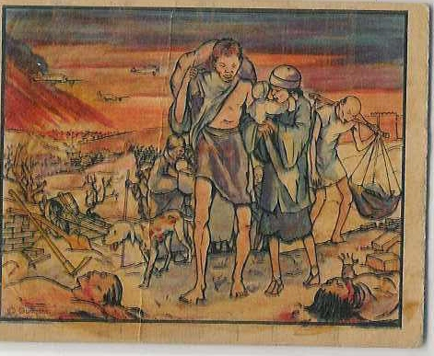

Slide 5
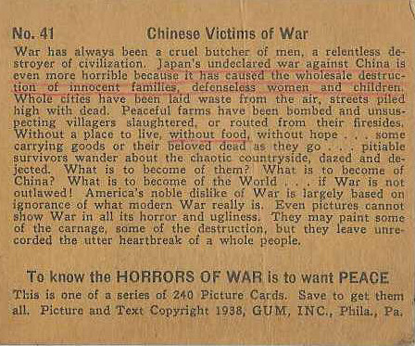

Slide 6
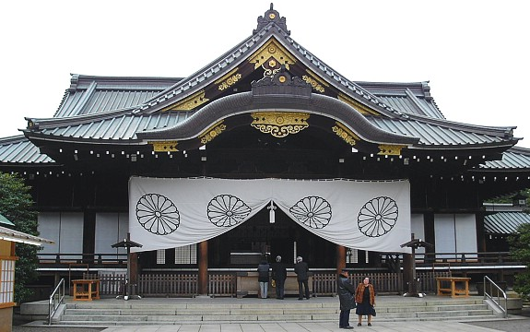
Yasukuni Shrine to Japanese War Dead

Slide 7
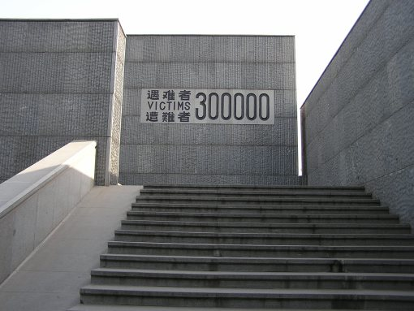
Nanjing Massacre Memorial Museum, Nanjing

Slide 8
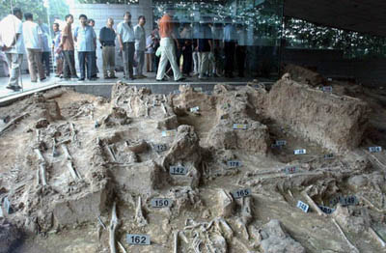
Nanjing Memorial Massacre Museum

